Slide 1
German Car Purchase Data Analysis
By Jadon Oliver

Slide 2

Project Overview
German Car Listing Dataset
Via Kaggle Csv Data File

Slide 3
Questions
Do manual or automatic vehicles get better mileage?
Is there a fuel type that is the most efficient for gas mileage?
Which vehicle fuel type has the most power (in kW)?
What is the average Price for cars in different ranges of gas mileage?
Is there a correlation between a car’s horsepower and its price?

Slide 4
Benefits and Purpose
Consumer Benefit
Private Seller Benefit
Car Dealership Benefit
Car Manufacturer Benefit

Slide 5

Key Data​ Points
Price in Euro
Power in kilowatts
Metric Horsepower
Transmission type (manual or automatic)
Fuel Type
Fuel consumption in liters per 100 km
Fuel consumption in grams per km
Mileage in km

Slide 6
Tools Used for data analysis
Jupyter notebooks
Pandas Python Library
Matplotlib Python Library
Seaborn Python Library

Slide 7
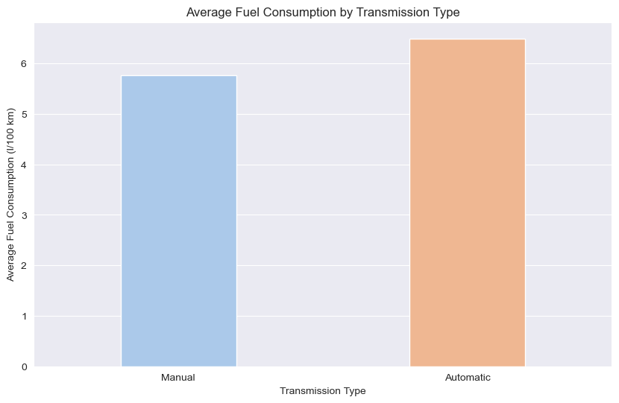
Question 1

Slide 8
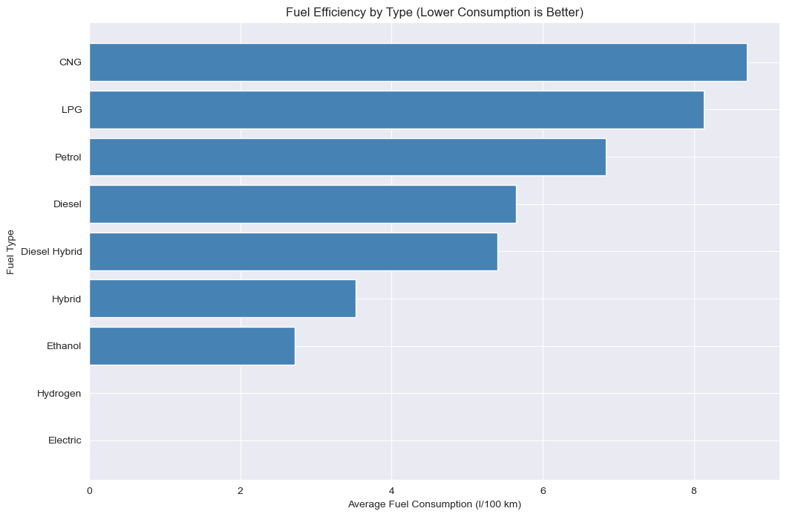
Question 2

Slide 9

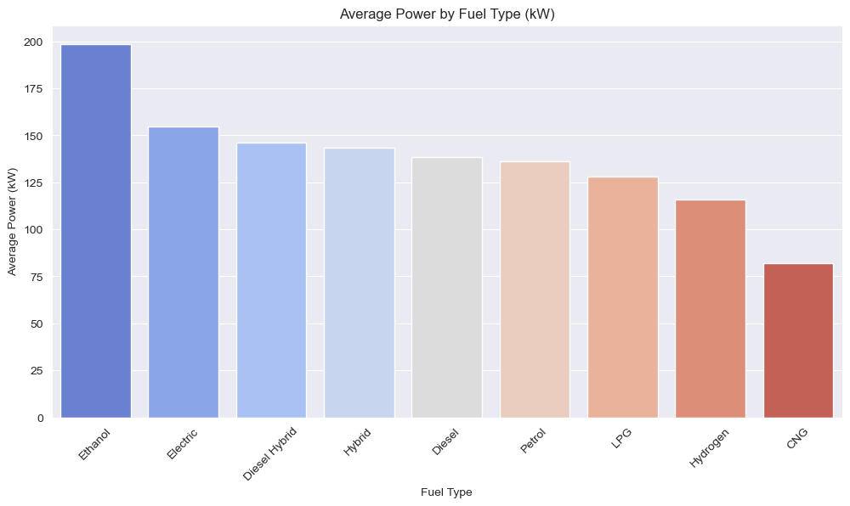
Question 3​

Slide 10
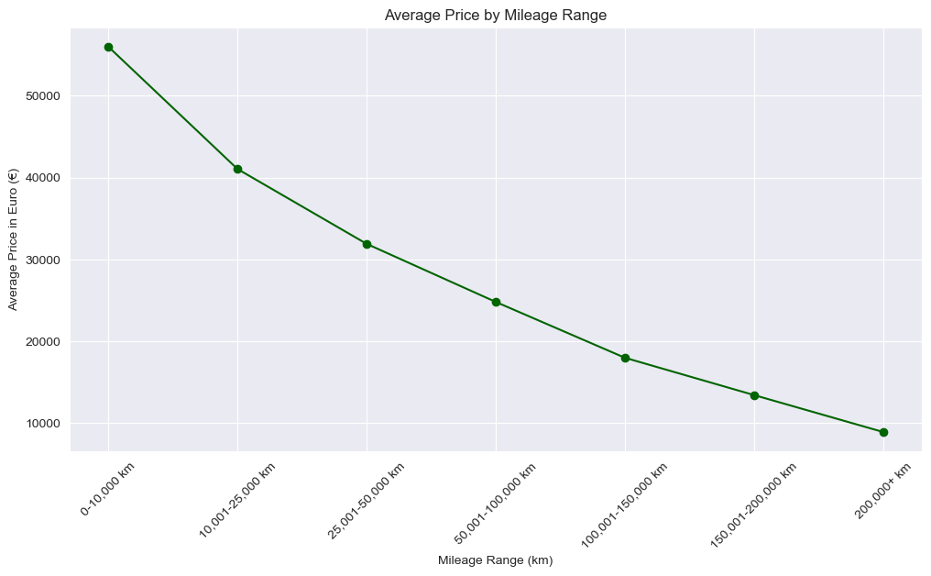
Question 4

Slide 11
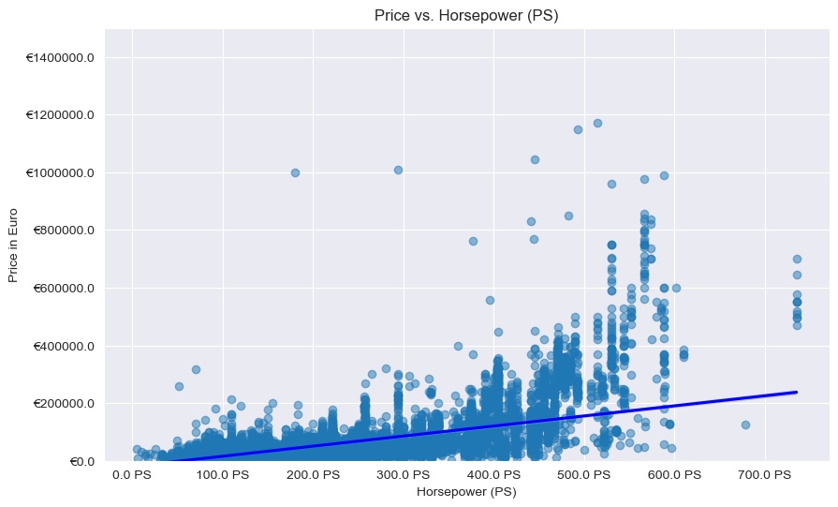
Question 5

Slide 12
Future Work
Look more into the statistics of specific car manufacturers.
Look at statistics relating to things like color and price.
Look at year statistics relating to price, mileage and fuel consumption.
Fuel type in relevance to car manufacturers.

Slide 13
THANK YOU!
Jadon Oliver

